Slide 1
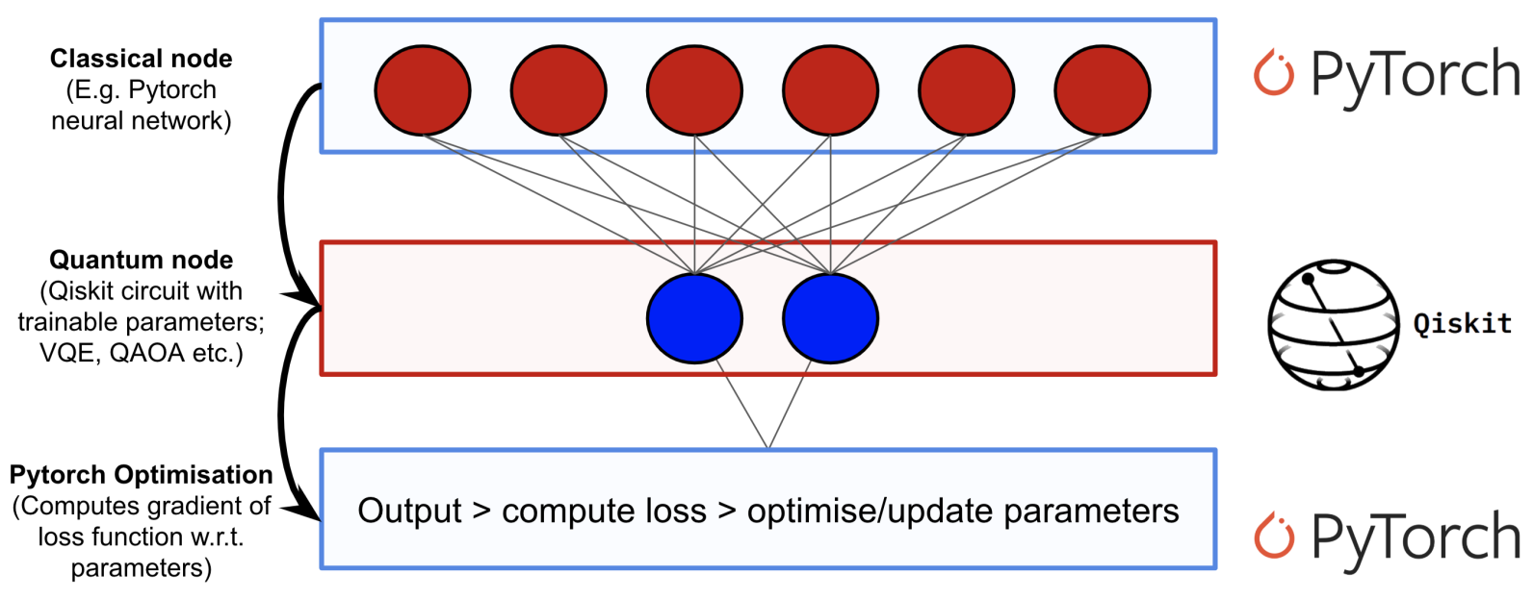
Qiskit and QML – 19th Nov 2020
Learn Quantum Computation using Qiskit

Slide 2
Agenda
8:15-9:00 Exam – multiple choice questions
9:00-9:15 Break
9:15-10:00 5 pages reports
10:00-10:15 Break
10:15-11:00 Exam – the rest
11:00-11:05 Break
11:05-11:30 Quantum Key Distribution BB84

Slide 3
1.1 Preliminaries
The background presented here on classical neural networks is included to establish relevant ideas and shared terminology; however, it is still extremely high-level. If you'd like to dive one step deeper into classical neural networks, see the well made video series by youtuber 3Blue1Brown. Alternatively, if you are already familiar with classical networks, you can skip to the next section.

Slide 4
Neurons and Weights
A neural network is ultimately just an elaborate function that is built by composing smaller building blocks called neurons. A neuron is typically a simple, easy-to-compute, and nonlinear function that maps one or more inputs to a single real number. The single output of a neuron is typically copied and fed as input into other neurons.

Slide 5
Neurons and Weights – cont’d
Graphically, we represent neurons as nodes in a graph and we draw directed edges between nodes to indicate how the output of one neuron will be used as input to other neurons. It's also important to note that each edge in our graph is often associated with a scalar-value called a weight. The idea here is that each of the inputs to a neuron will be multiplied by a different scalar before being collected and processed into a single value. The objective when training a neural network consists primarily of choosing our weights such that the network behaves in a particular way.

Slide 6
Feed Forward Neural Networks
It is also worth noting that the particular type of neural network we will concern ourselves with is called a feed-forward neural network (FFNN). This means that as data flows through our neural network, it will never return to a neuron it has already visited. Equivalently, you could say that the graph which describes our neural network is a directed acyclic graph (DAG). Furthermore, we will stipulate that neurons within the same layer of our neural network will not have edges between them.

Slide 7
IO Structure of Layers
The input to a neural network is a classical (real-valued) vector. Each component of the input vector is multiplied by a different weight and fed into a layer of neurons according to the graph structure of the network. After each neuron in the layer has been evaluated, the results are collected into a new vector where the i'th component records the output of the i'th neuron. This new vector can then be treated as an input for a new layer, and so on. We will use the standard term hidden layer to describe all but the first and last layers of our network.

Slide 8
2. So How Does Quantum Enter the Picture?
To create a quantum-classical neural network, one can implement a hidden layer for our neural network using a parameterized quantum circuit. By "parameterized quantum circuit", we mean a quantum circuit where the rotation angles for each gate are specified by the components of a classical input vector. The outputs from our neural network's previous layer will be collected and used as the inputs for our parameterized circuit. The measurement statistics of our quantum circuit can then be collected and used as inputs for the following layer. A simple example is depicted below:

Slide 9
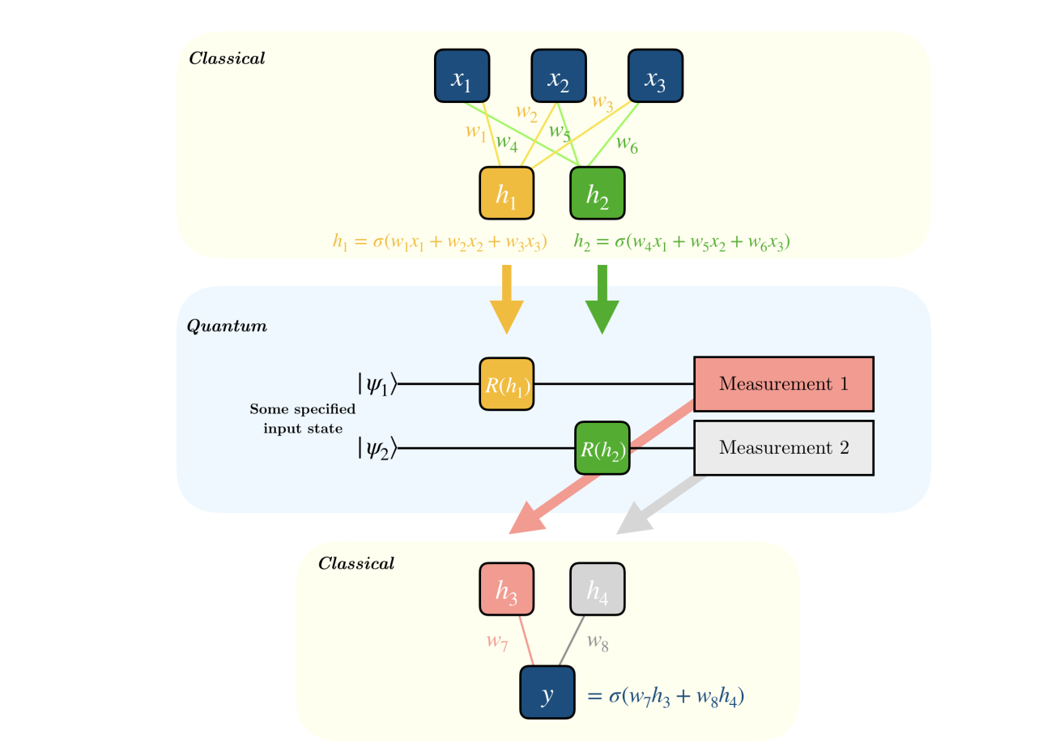
2. So How Does Quantum Enter the Picture?
Here, σσ is a nonlinear function and hihi is the value of neuron ii at each hidden layer. R(hi)R(hi) represents any rotation gate about an angle equal to hihi and yy is the final prediction value generated from the hybrid network.

Slide 10
Starting the Qiskit/mybinder.org
https://mybinder.org/v2/gh/Qiskit/qiskit-tutorial/master?filepath=index.ipynb

Slide 11
Qiskit and VQE Variational Quantum Eigensolver
https://www.youtube.com/watch?v=Z-A6G0WVI9w

Slide 12
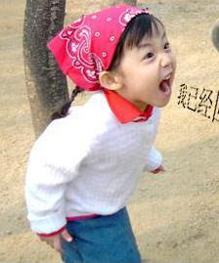
1. Motivation and Introduction
What? Why?

Slide 13

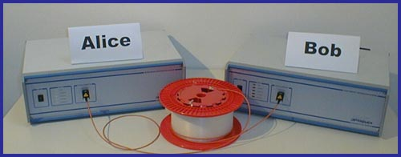
Commercial Quantum Crypto products available on the market Today!
MAGIQ TECH.
Distance over 100 km of
commercial Telecom fibers.
ID QUANTIQUE

Slide 14
Bad News (for theorists)
Theory of quantum key distribution (QKD) is behind experiments.
Opportunity:
By developing theory, one can bridge gap between theory and practice.

Slide 15
Happy Marriage
Theory and Experiment go hand in hand.

Slide 16
Key Distribution Problem
Eve
Alice
Bob
Alice and Bob would like to communicate in absolute
security in the presence of an eavesdropper, Eve.
To do so, they need to share a common random string
of number----key

Slide 17
Bennett and Brassard’s scheme (BB84)
Alice
Bob
ASSSUMPTIONS:
Source: Emits perfect single photons. (No multi-photons)
Channel: noisy but lossless. (No absorption in channel)
Detectors: a) Perfect detection efficiency. (100 %)
Basis Alignment: Perfect. (Angle between X and Z basis is exactly 45 degrees.)
Assumptions lead to security proofs:
Mayers (BB84), Lo and Chau (quantum-computing protocol),
Biham et al. (BB84), Ben-Or (BB84), Shor-Preskill (BB84), …
Conclusion: QKD is secure in theory.

Slide 18
Reminder: Quantum No-cloning Theorem
An unknown quantum state CANNOT be cloned. Therefore, eavesdropper, Eve, cannot have the same information as Bob.
Single-photon signals are secure.
a
a
a
IMPOSSIBLE
Notes:
Quick/skip

Slide 19
Photon-number splitting attack against multi-photons
A multi-photon signal CAN be split. (Therefore, insecure.)
a
a
a
Bob
Splitting attack
a
Alice
Eve
Summary: Single-photon good.
Multi-photon bad.

Slide 20
QKD : Practice
Reality:
1. Source: (Poisson photon number distribution)
Mixture. Photon number = k with probability:
Some signals are, in fact, double photons!
Channel: Absorption inevitable. (e.g. 0.2 dB/km)
Detectors:
(a) Efficiency ~15% for Telecom wavelengths
(b) “Dark counts”: Detector’s erroneous fire.
Detectors will claim to have detected signals with
some probability even when the input is a vacuum.
4. Basis Alignment: Minor misalignment inevitable.
Question: Is QKD secure in practice?

Slide 21
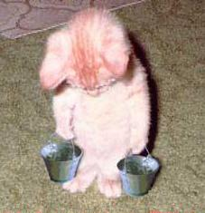
2. Problem
Help!

Slide 22
Big Problem: Nice guys come last
Alice:
Problems: 1) Multi-photon signals (bad guys) can be split.
2) Eve may suppress single-photon signals (Good guys).
Bob:
Eve:
Eve may disguise herself as absorption in channel.
QKD becomes INSECURE as Eve has whatever Bob has.
Signature of this attack: Multi-photons are much more likely to reach Bob than single-photons.
(Nice guys come last).

Slide 23
Yield as a function of photon number
Let us define Y_{n} = yield
= conditional probability that a signal
will be detected by Bob, given that it is
emitted by Alice as an n-photon state.
Bob:
Eve:
For example, with photon number splitting attack:
Y₂ = 1 : all two-photon states are detected by Bob.
Y₁ = 0 : all single-photon states are lost.

Slide 24
Figures of merits in QKD
# of Secure bits per signal (emitted by Alice).
How long is the final key that Alice and Bob can generate?
(Maximal) distance of secure QKD.
How far apart can Alice and Bob be from each other?

Slide 25
Prior Art Result
Consider the worst case scenario where all signals received by Bob are bad guys. (Insecure.)
To prevent this from happening, we need:
# of signals received by Bob
> # of multi-photon signals emitted by Alice.
Consider channel transmittance η.
For security, we use weak Poisson photon number
distribution: μ = O (η).
Secure bits per signal S = O (η²).

Slide 26
Big Gap between theory and practice of BB84
Theory Experiment
Key generation rate: S = O (η²). S= O (η).
Maximal distance: d ~ 35km. d >120km.
Prior art solutions (All bad):
Use Ad hoc security: Defeat main advantage of Q. Crypto. : unconditional security. (Theorists unhappy ☹.)
Limit experimental parameters: Substantially reduce performance. (Experimentalists unhappy ☹.)
Better experimental equipment (e.g. Single-photon source. Low-loss fibers. Photon-number-resolving detectors): Daunting experimental challenges. Impractical in near-future. (Engineers unhappy ☹.)
Question: How can we make everyone happy ☺?

